Slide 1

Expert Systems
A2 | Digital Technology

Slide 2
Describe the structure of an expert system
Describe the purpose of the knowledge base and inference engine in an expert system
Explain the following terms in relation to expert systems:
  Shell
  Heuristics
  Fuzzy Logic
  Knowledge Engineer
Evaluate the use of expert systems in medicine, car engine fault diagnostics and life insurance
LEARNING INTENTIONS

Slide 3


What is an Expert?
An expert is an experienced practitioner in a particular field for example a medical specialist, a repair technician or a financial analyst.

Slide 4

What is an Expert System?
An application of artificial intelligence to a particular area of activity where traditional human expert knowledge and experience are made available through a computer package.
  Very ‘knowledge rich’, whereby the subject is often represented as ‘facts and rules’
Expert systems use a design strategy where the separation of the subject knowledge from the rules of logic (inference) that are to be used
  An inference engine and the knowledge base are essential components of an expert system
An expert system is almost always used in a narrow field of knowledge. The field of knowledge is called the knowledge domain of the system.
Notes:
Expert systems are also known as knowledge based-systems. An expert system is an application of artificial intelligence. In this case, the knowledge of a human expert is made available through a computer package.

Slide 5

Knowledge Base & Inference Engine
Knowledge Base: Part of an expert system that holds knowledge about the application area (or domain). Often much of the knowledge is held in IF…THEN… type rules and this knowledge is called a rule base.
  The knowledge of the human expert is programmed into the expert system and is represented using rules and facts.
Inference Engine: A piece of software in an expert system that interrogates the knowledge base and as a result draws inferences (a conclusion reached on the basis of evidence and reasoning.) or conclusions.
  In short, once the knowledge base has been created, a system for consulting it must be put in place. This is known as the inference engine.

Slide 6

Inference Engine
This software interrogates the knowledge base and draws inferences and conclusions based on the rules stored about the subject domain.
The inference engines poses questions to the user and uses the answers provided by the user to determine a suitable response. It can be described as the brain of the expert system.
Examples of questions that a medical diagnosis tool may ask would be:
  Do you have a cough? Yes/No
  Do you have sore ears? Yes/No
Examples of rules that allow the inference engine to determine and answer would be:
  IF the patient has a cough AND sore ears, THEN the diagnosis is a severe head cold.
Notes:
Inference: a conclusion reached on the basis of evidence and reasoning.

Slide 7
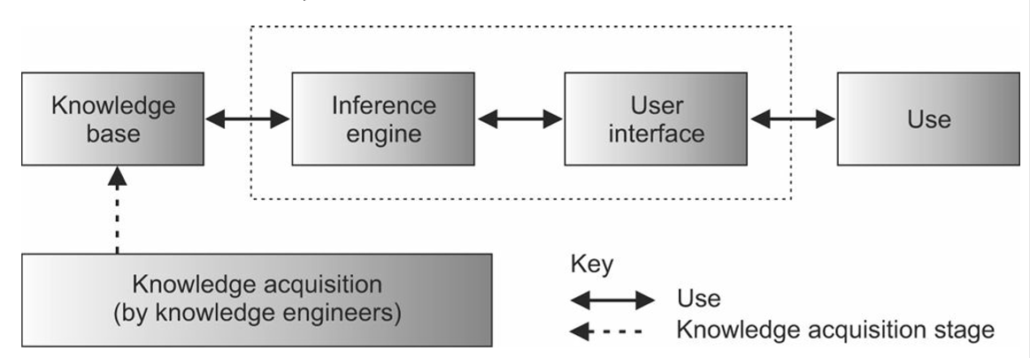
The Shell
A piece of software that is an ‘empty’ expert system without the knowledge base for any particular application, and is used to create a new expert system.
It is described as an empty or skeletal expert system without a knowledge base
The creator can then add appropriate rules and facts to generate an expert system.

Slide 8



Rules that are not derived purely from logic, but are derived from human experience and intuition. These are known as ‘rules of thumb’. Many of the rules in an expert system are of this type.
Facts that may be in an expert system:
  Water boils at 100 degrees Celsius
  The personal allowance before tax is £11,500
  Any person over the age of 17 can apply for a driver’s licence
Rules may include
  If water reaches its boiling point, steam will be produced.(Chemical expert system)
  A person is not taxed if they earn less than £11,500 (financial expert system)
  Insurance policies for young people tend to be more expensive. (insurance company expert system)
HEURISTICS

Slide 9
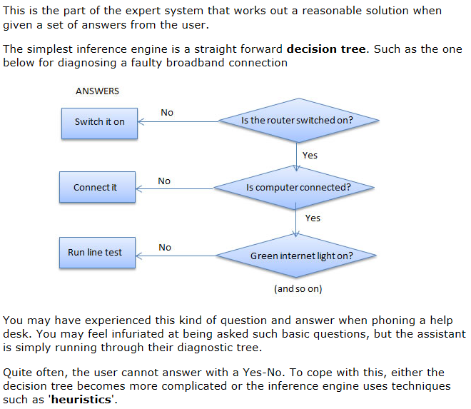


Heuristics
Rules of thumb which are derived from human experience and intuition. Rather than just purely logic, it requires judgement and estimations.

Slide 10

FUZZY LOGIC
A means of working with uncertain knowledge.
Whereas in classical logic we treat statements as being true or false, in fuzzy logic we give each of these possibilities a certainty factor between 0 and 1.
Fuzzy logic is used in searching for text in a document or index; if the given text is imprecise fuzzy logic allows the software to find the ‘match’ that has the greatest degree of truth and is close.
Many expert systems use natural language as part of the user interface. This is not easily translated simply to values of 0 and 1. For example a person may describe the time of day as ‘almost midday’.

Slide 11

Fuzzy Logic Example: Is it Hot?
Boolean Logic
Fuzzy Logic
Yes
No
Very Hot
Fairly Hot
Moderately
Fairly Cool
Very Cold
1
0.9
0
0.75
0.5
0.25
0.1
Fuzzy logic uses probabilities or ‘degrees of truth’ instead of true & false/Boolean logic. Decisions can be made with uncertain or incomplete data. Thus, computers can mimic human reasoning using this method.
Fuzzy logic is designed to solve problems by making the best possible decision given the uncertain input.

Slide 12


Knowledge Engineer
The people who collect the information for the knowledge base. This information is acquired from a variety of sources in a variety of ways;
  One of the most important is eliciting information through talking to experts
The technical expert who obtains the information, facts and rules as part of the knowledge acquisition.
They use this to form the knowledge base from subject experts in a particular field.
This can be achieved from structured or unstructured interviews and concept maps. They structure the knowledge into the database, and even validates/verifies the knowledge.

Slide 13
Q: Explain the meaning of each of the following terms:
Expert system shell [3]
Fuzzy Logic [3]
Heuristics [3]
This assist/automates the creation of the expert system [1]
It is an empty or skeletal expert system [1]
For a particular application, the relevant rules and facts are added [1]
Deals with uncertainties [1]
Statements are assigned probabilities [1]
Rather than being true or false [1]
These are rules [1]
Derived form human experience [1]
Or intuition [1]

Slide 14

Use of Expert Systems: Medicine
The knowledge base will contain information and rules about illnesses and symptoms
The patient responds to questions and the expert system provides a diagnosis of the patient’s illness
Benefits | Drawbacks
﻿The expert system's knowledge can reflect the knowledge of a large number of medical experts The expert system will produce accurate and consistent diagnoses Make rational decisions without any emotional overhead Knowledge of expert staff can be captured to some extent before they move on to new locations or jobs Can be used as a training aid to increase the expertise of staff Efficient way of providing answers to queries (reducing wait times) as it does not involve additional help to staff Natural language interface would make the expert system more human friendly | The expert system cannot use intuition Overreliance on expert systems could lead to a loss of human expertise/skills A lot of effort and cost has to go into making a good expert system Not as good as having human experts to hand Most expert systems are menu driven which does not deal very well with ambiguous problems Does not learn from mistakes unless user feedback and human maintenance is part of its ongoing development

Slide 15

Use of Expert Systems: Car Engine Fault Diagnostics
The expert system contains the knowledge of a large number of car designers/mechanics.
The expert system is plugged into the car.
It carries out a series of automatic tests and determines the fault.
Benefits | Drawbacks
Very accurate diagnosis Very consistent diagnosis Reasoning provided Conclusions explained | Human intuition cannot be replaced Risk of over-reliance on technology Human expert knowledge may be devalued.

Slide 16

Use of Expert Systems: Life Insurance
Life insurance premiums depends on factors such as age, gender, smoking status, health
The expert system will ask the applicant a series of health-related questions and use the answers with its inference engine and knowledge base to calculate the premium for that applicant
Benefits | Drawbacks
The expert system can calculate premiums very accurately and consistently Can provide reasoning and probabilities The calculations can be based on the experience of a large number of insurance consultants | There is a risk of over reliance on technology Consultants may become deskilled A consultant may take into account special circumstances which the expert system may overlook

Slide 17
An expert system can be used to diagnose faults in car engines.
Q. Evaluate this use of an expert system [6]

Slide 18
An expert system can be used to diagnose faults in car engines.
Q. Evaluate this use of an expert system [6]
STEP
1
STEP
2
STEP
3
State Definition
The expert system contains the knowledge of a large number of car designers.
The expert system is plugged into the car.
It carries out a series of automatic tests and determines the fault.
Use Key/Specialist Terms
The expert system contains the knowledge of a large number of car designers as part of its knowledge base.
The expert system is plugged into the car.
It carries out a series of automatic tests and determines the fault using fuzzy logic and/or heuristics.
Add Explanation or Pros/Cons
The expert system contains the knowledge of a large number of car designers as part of its knowledge base. The expert system is plugged into the car. It carries out a series of automatic tests and determines the fault using fuzzy logic and/or heuristics.
This gives very accurate, consistent diagnosis, and often will provide reasonings for its conclusions. However, human intuition cannot be replaced and this leaves to an overreliance on technology

